Slide 1
Joshua Jones
21/08/2016 current phase is L
Project Number | FS-17-0006
Project Name | Impact Attenuator Plate
Deliverables | Plate welded to chassis front bulkhead wit holes for mounting of the impact attenuator, cardboard model of impact attenuator, bolts. Pate must be have holes to mount front nosecone body work and possibly fron bulkhead bodywork
Target Start Date | 15/08/2016
Target Delivery Date
Justification | mounting point for impact attenuator
Resource (Cash) | £250
Research Time (days) | 3
Design time (days) | 1
Fabrication time (days) | 21
Phase | Project Steps
A | Detailed Justification / Establish Project Targets
B | Rule Check
C | Limitations and Spaceclaim
D | Concept Design
E | Review 1 / concept selection
F | Selection of components / materials + produce initial BOM
G | Detailed Design
H | Review 2 / design review
I | Manufacturing and assembly pack
J | Sourcing Suppliers
K | Final BOM and installation requirements
L | Review 3 / Purchasing approval
M | Installation
N | Project Close out / installation inspection
Acronyms:
IA = Impact Attenuator
AIP = Anti Intrusion Plate

Slide 2
Detailed Justification / Establish Project Targets Rule Check
T3.20 Impact Attenuator (IA)
T3.20.1 Forward of the Front Bulkhead there must be an Impact Attenuator Assembly, consisting of an Impact
Attenuator and an Anti-Intrusion Plate.
T3.20.2 The Impact Attenuator must be:
a. At least 200 mm (7.8 in) long, with its length oriented along the fore/aft axis of the Frame.
b. At least 100 mm (3.9 in) high and 200 mm (7.8 in) wide for a minimum distance of 200 mm
(7.8 in) forward of the Front Bulkhead.
c. Attached securely to the Anti-Intrusion Plate or directly to the Front Bulkhead.
An officially approved “standard” Impact Attenuator may be found in Appendix T-3.
T3.20.3 The Anti-Intrusion Plate must:
a. Be a 1.5 mm (0.060 in) solid steel or 4.0 mm (0.157 in) solid aluminium plate, or an approved
alternative as per T3.38.
b. Attach securely and directly to the Front Bulkhead.
c. Have an outer profile that meets the requirements of T3.20.5.
T3.20.4 The accepted methods of attaching the Impact Attenuator Assembly, Impact Attenuator and AntiIntrusion Plate are: a. Welding, where the welds are either continuous or interrupted. If interrupted, the weld/space ratio must be at least 1:1. All weld lengths must be greater than 25 mm (1”). b. Bolted joints, using a minimum of eight (8) 8 mm Metric Grade 8.8 (5/16” SAE Grade 5) bolts with positive locking. The distance between any two bolt centres must be at least 50 mm (2”).

Slide 3
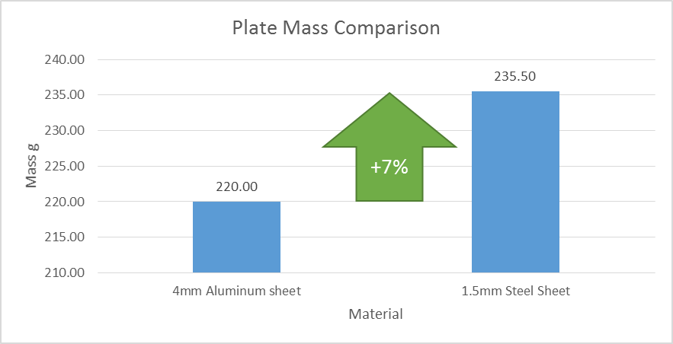
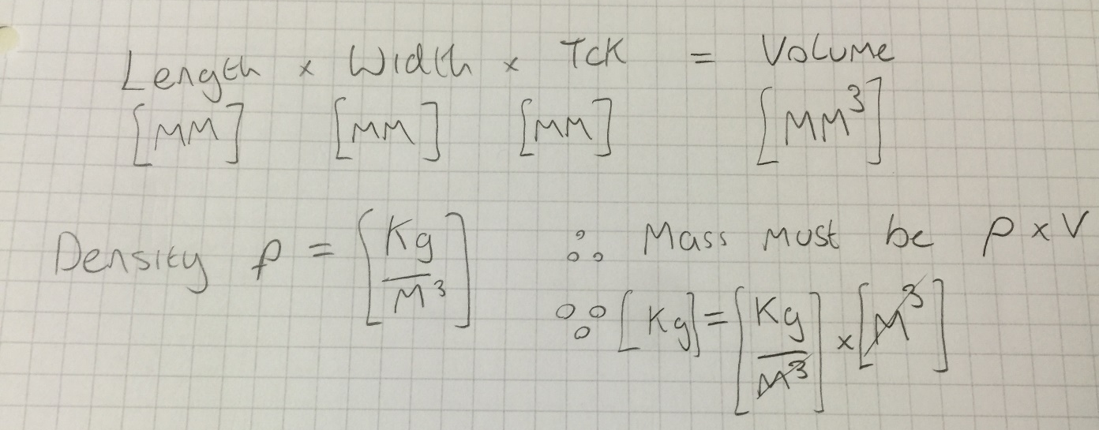
Quick Calculation (sense check)
Steel is more dense, but we can use thinner sheet so which is heavier? Let’s think about a 200x100x Thickness sheet,
Density of steel is 7850 kg/m^3, Aluminium is 2750

Slide 4
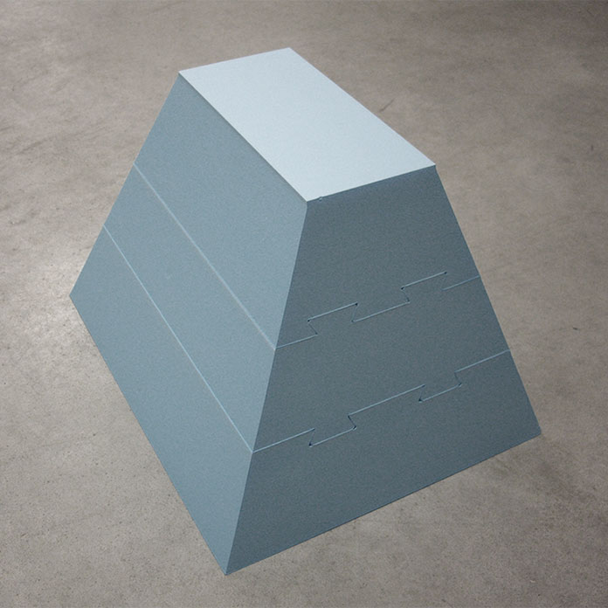
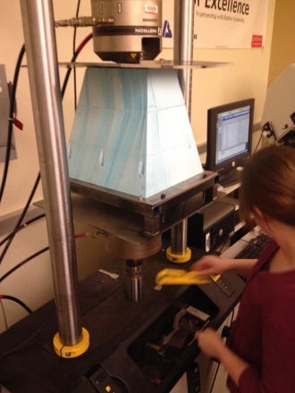
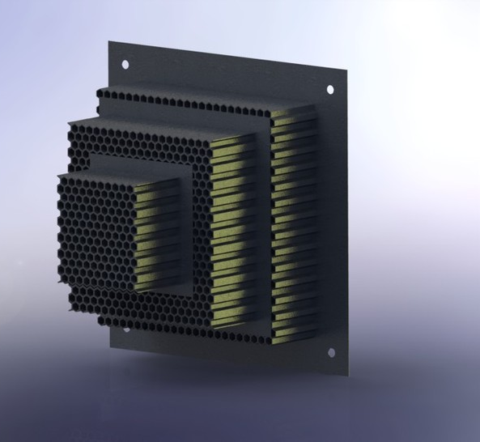
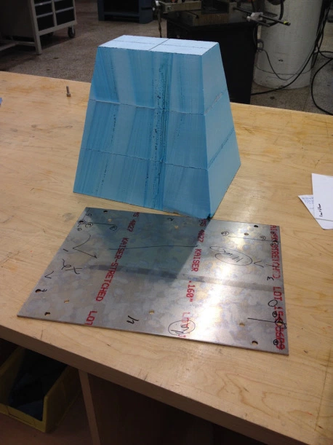
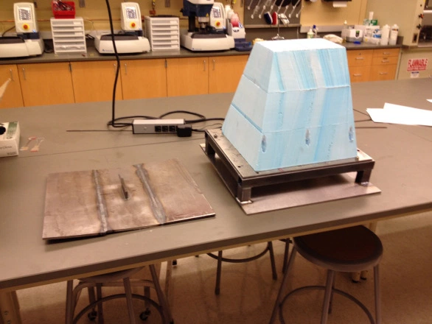
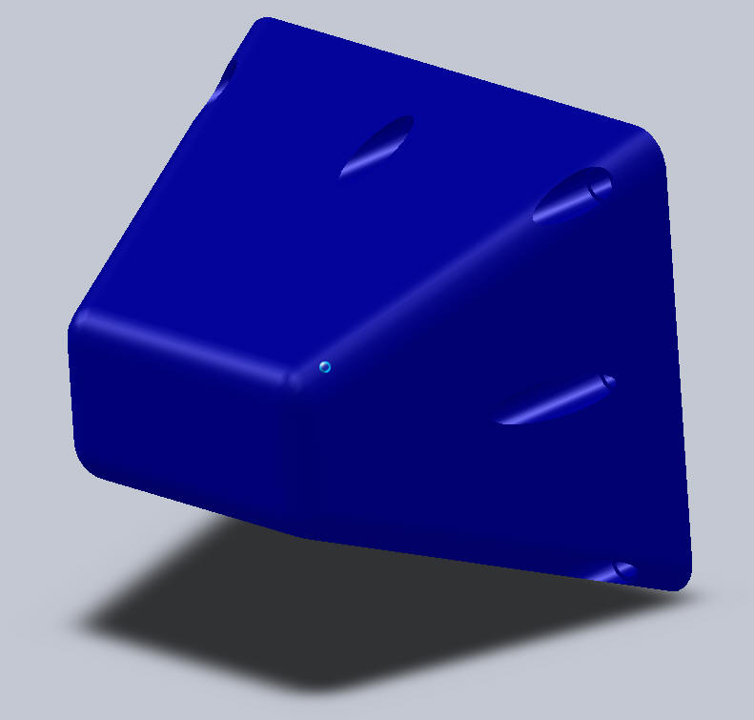
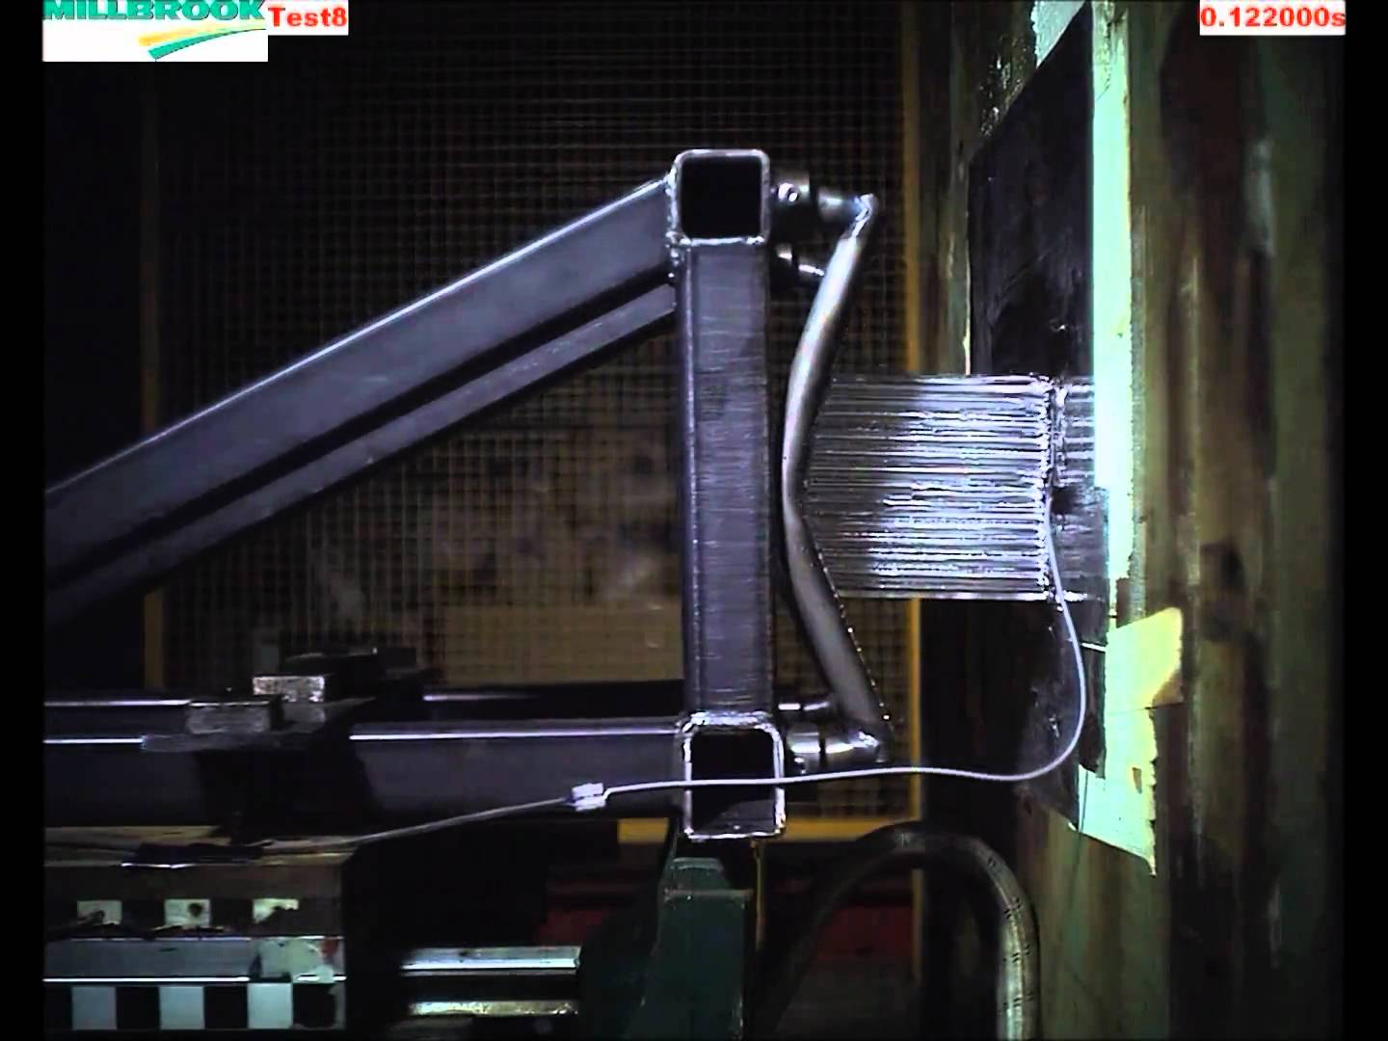
Design Inspiration
https://yungprojects.files.wordpress.com
http://fsaeparts.com/

Slide 5
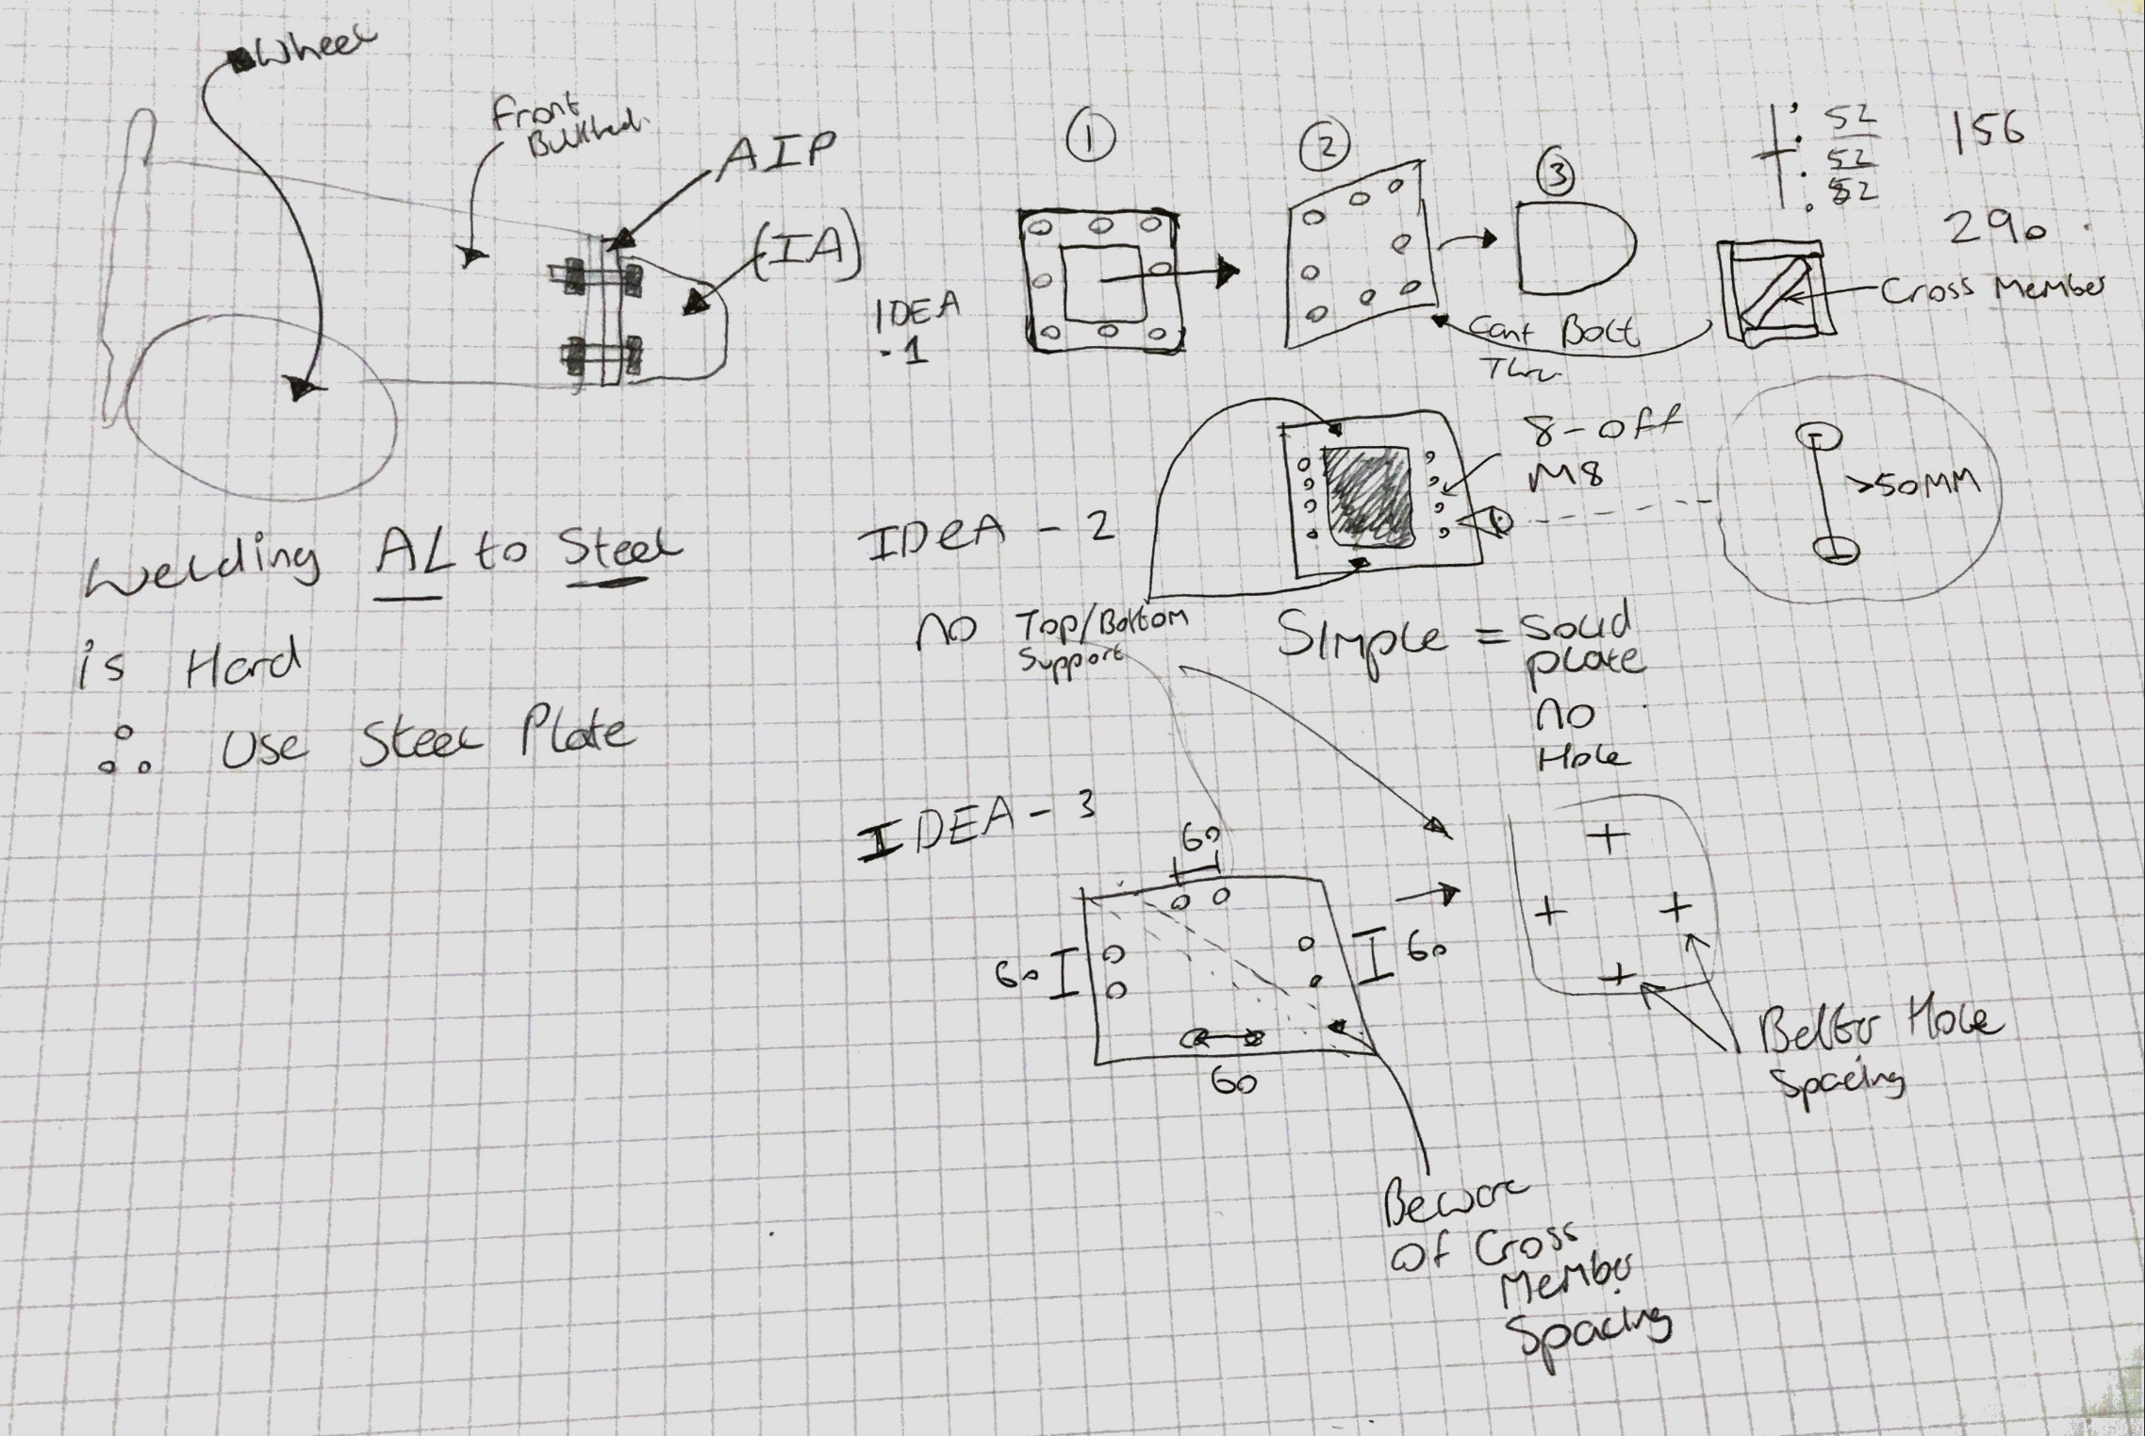

Slide 6
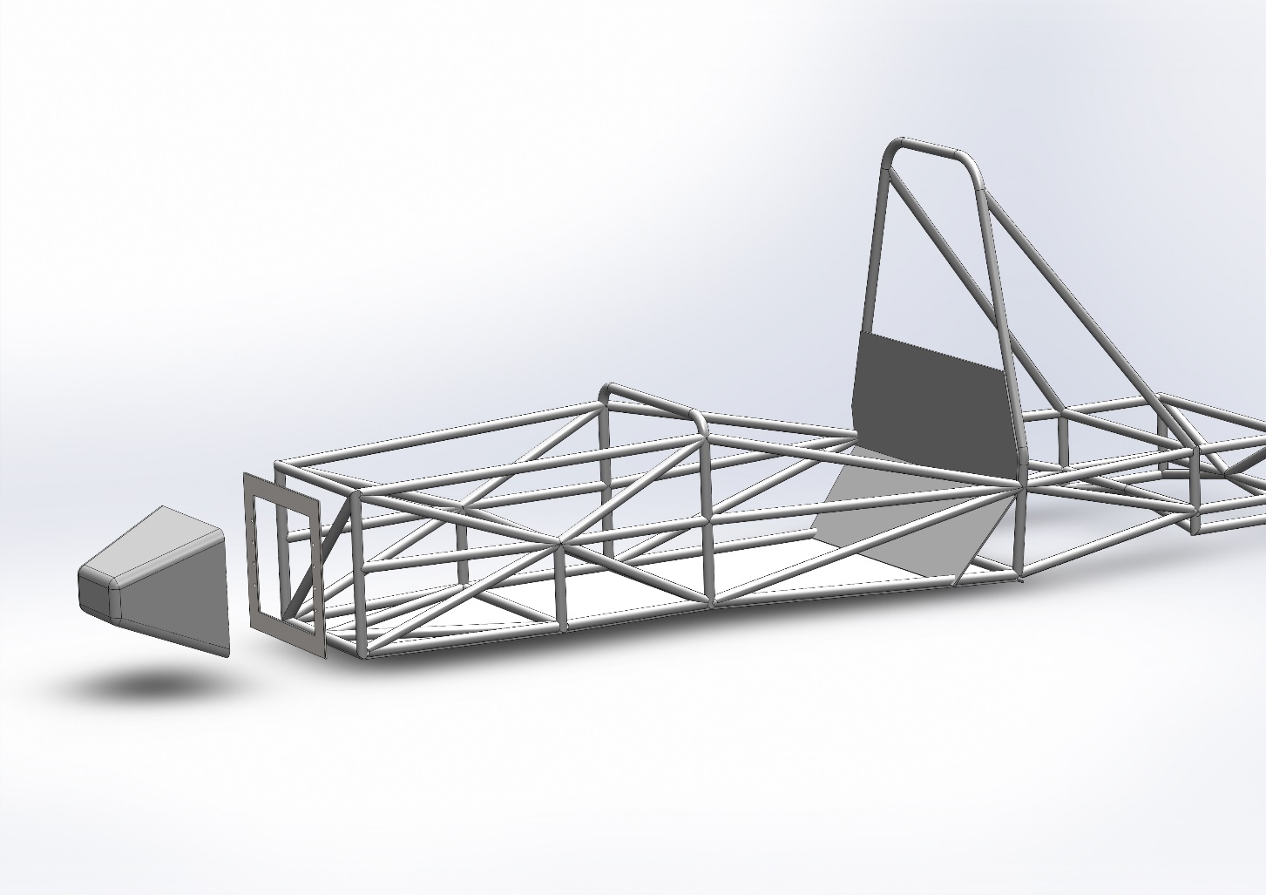
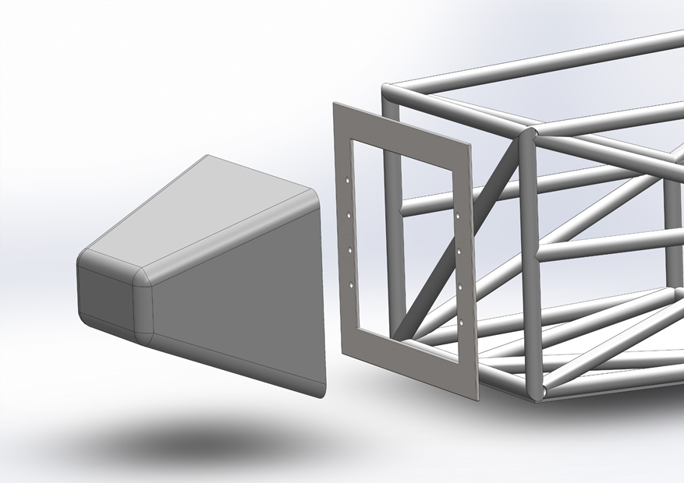
Early Space-Claim / Design Sizing

Slide 7
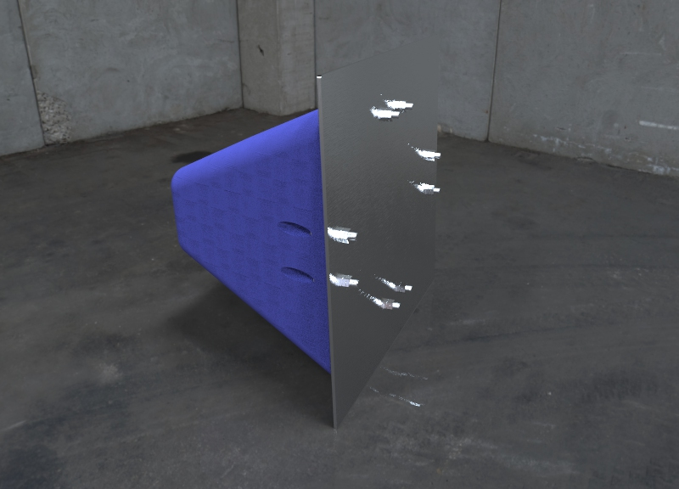
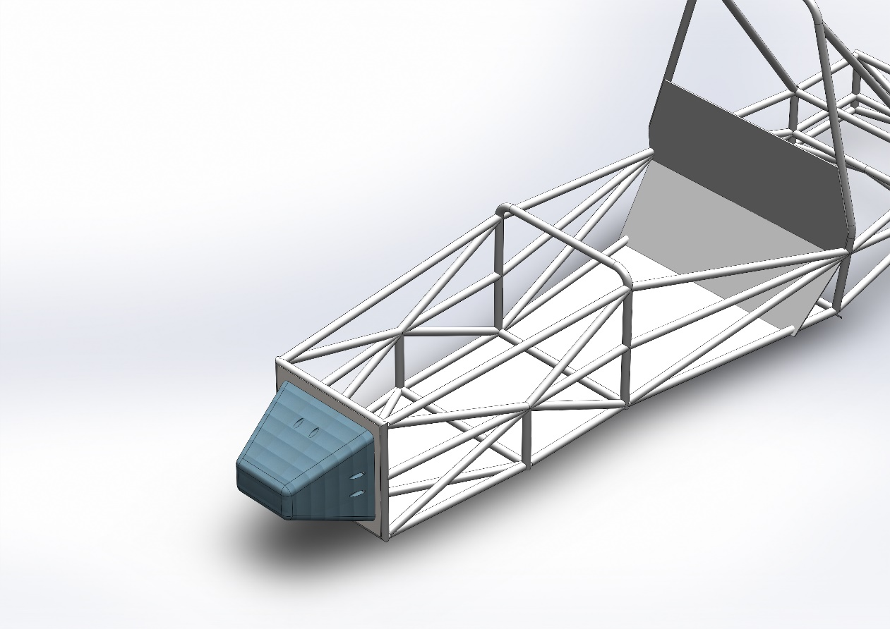
Detailed design
Note no hole in plate after checking the rules

Slide 8
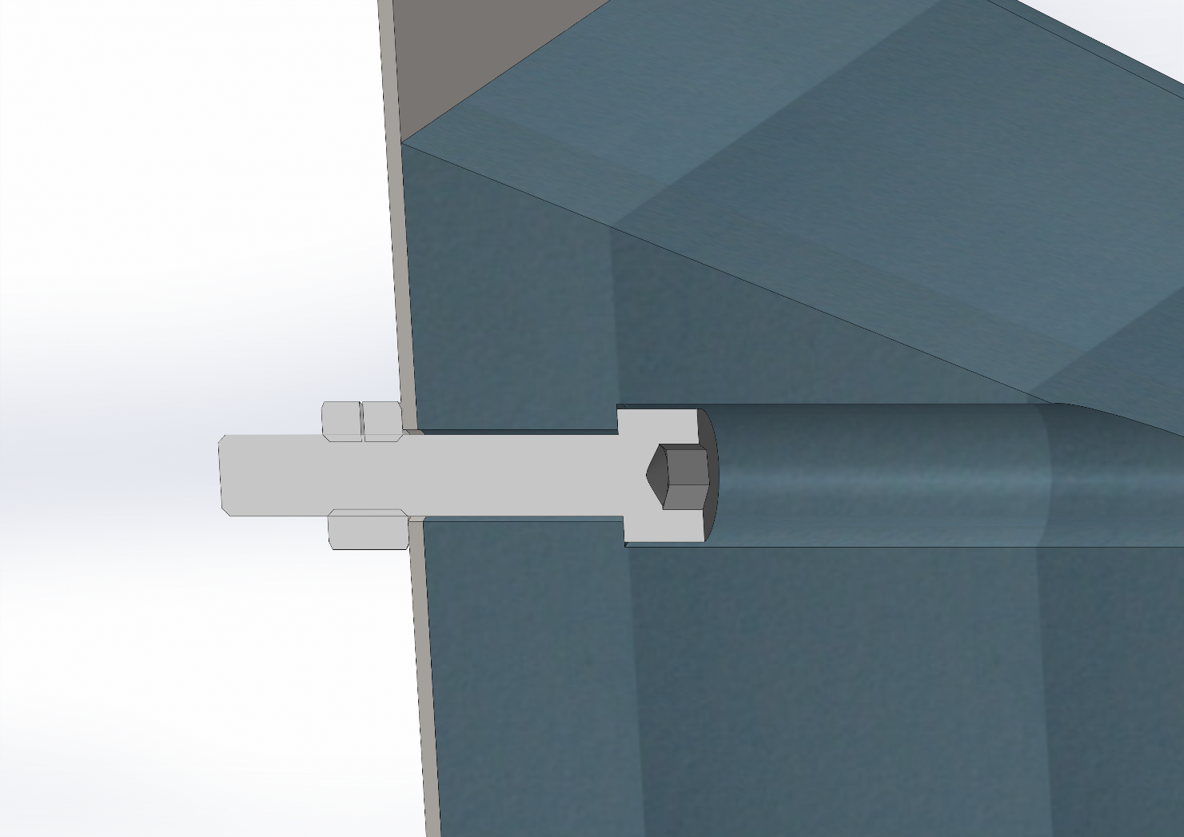
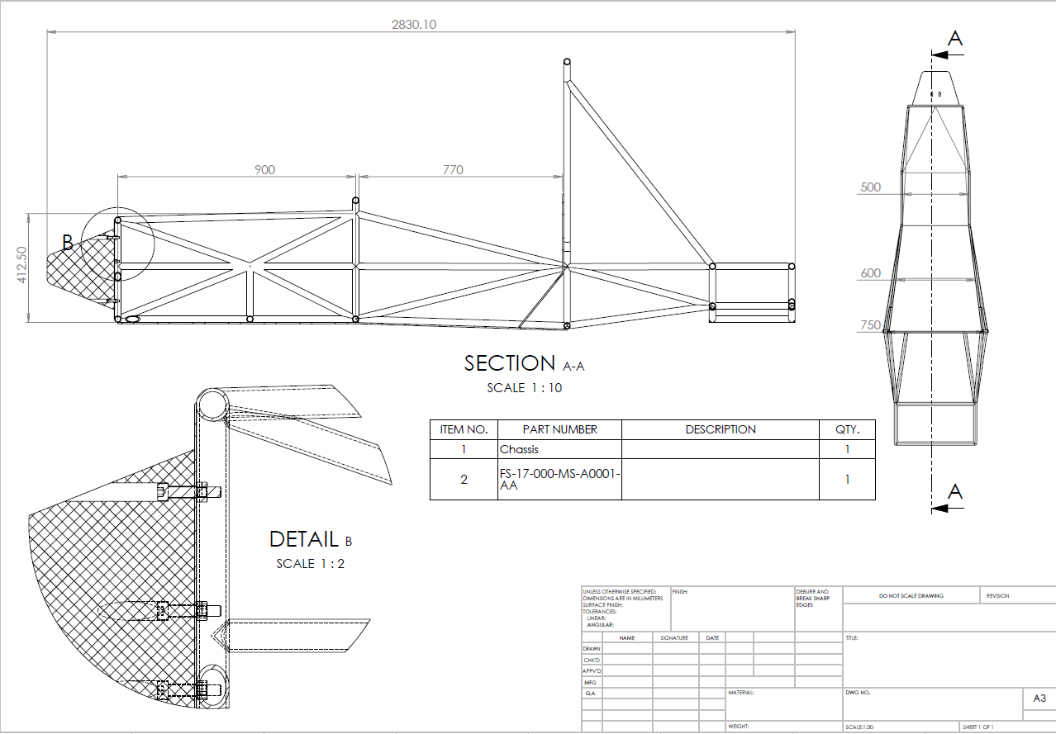
Detailed design
Full production drawings are in the design folder

Slide 9
 | BOM | Bill Of Materials
Nomenclature | Line Num. | Area of Commodity | Asm/Prt # | Rev. Lvl. | Asm | Component | Description | Unit Cost | Quantity | Material Cost | Process Cost | Fastener Cost | Tooling Cost | Total Cost | Details Page Number
FS-17-000-MS-A0001-AA | 1 | Miscellaneous, Fit & Finish | A0001 | AA |  | Impact Attenuator | Assembly for Impact Attenuator |  | 1
FS-17-000-MS-00001-AA | 2 | Miscellaneous, Fit & Finish | 00001 | AA | Impact Attenuator | Plate | Anti intrusion plate |  | 1
FS-17-000-FS-00002-AA | 3 | Fasteners | 00002 | AA | Impact Attenuator | M8 Bolt | m8 x 40 standard thread 1.25 http://uk.rs-online.com/web/p/socket-screws/4838411/ | £0.29 | 8 |  |  |  |  | £2.32
FS-17-000-FS-00003-AA | 4 | Fasteners | 00003 | AA | Impact Attenuator | M8 Nut | http://uk.rs-online.com/web/p/locking-nuts/1224373/ | £0.06 | 8 |  |  |  |  | £0.45
FS-17-000-MS-00004-AA | 5 | Miscellaneous, Fit & Finish | 00004 | AA | Impact Attenuator | Impact Attenuator | Foam Pyramid Attenuator https://www.rollbarpadding.com/product.asp?id=48 https://www.rollbarpadding.com | £122.35 | 1 |  |  |  |  | £122.35
 | 6
 | 7
 | 8
 | 9
Within the £250 initial budget

